Slide 1
Uplink Scheduling in Wireless Mesh Networks
Mieso K. Denko and Liang Ma
Present by Y.W. Lee

Slide 2
Agenda
Abstract
Introduction
Proposed fair scheduling
Performance evaluation
Conclusion

Slide 3
Agenda
Abstract
Introduction
Proposed fair scheduling
Performance evaluation
Conclusion

Slide 4
Abstract
802.11 based wireless mesh networks suffer from unfairness
Existing solutions focus on hard fairness
we propose a multi-objective optimization technique to achieve fairness and maximize network throughput through unused bandwidth reallocation.

Slide 5
Agenda
Abstract
Introduction
Proposed fair scheduling
Performance evaluation
Conclusion

Slide 6
Introduction
Wireless mesh networks (WMNs) often consist of
  mesh routers
  mesh clients
  gateways
The throughput of each mesh router may differ significantly due to the geographical distribution of nodes in the network.

Slide 7
Introduction
Users in WMN typically pay the same flat rate to their Internet service provider, they expect to receive the same quality of service from the network.
Two important parameters in resource allocation in WMNs are :
  Fairness
  Throughput maximization

Slide 8
Introduction
Centralized scheme
  Each mesh router collects information on the global topology including link capacities and offered traffic
Queue management scheme
  Weighted per-flow queue management
  High implementation cost
  Without a MAC layer support may waste a significant amount of bandwidth when there are over-injected packets
Notes:
(related work)

Slide 9
Introduction
The main contributions of this paper are as follows:
  we propose a fair scheduling method that applies the concept of multi-objective optimization to maximize network throughput while also achieve fairness.
  we formulate a linear programming problem and solve the maximum bandwidth rate allocation problem to allocate bandwidth rate to each mesh router and satisfy user demand.

Slide 10
Agenda
Abstract
Introduction
Proposed fair scheduling
Performance evaluation
Conclusion

Slide 11
Proposed fair scheduling
In WMNs, unfair bandwidth sharing may arise since the CSMA/CA protocol is designed to provide per station fairness only in one hop.
We design and implement a fair scheduling algorithm and formulate a linear programming model to solve the fairness and throughput problem.
The proposed fair scheduling method is a hybrid of hard fairness and progressive filling in max-min fairness.
Notes:
As the hop count from a mobile client to the gateway
node increases, throughput of the node decreases drastically.

Slide 12
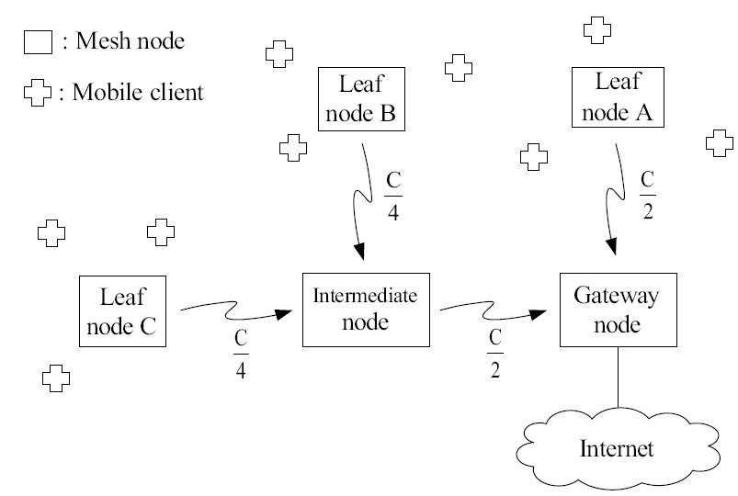
Proposed fair scheduling
If the offered load is enough to saturate the wireless channel…

Slide 13
A . The network model
We consider a wireless mesh network that is composed of internet gateway (IGW) and multiple mesh routers (MR).
We represent the mesh network as a directed graph G={N,L}
  N : vertices
  L : directed links
A link (i.j) between and means that these two MRs are within transmission range of each other and can communicate.
The mesh routers are capable of forwarding packets to the IGWs directly or via other mesh routers.

Slide 14
B . Throughput and fairness
In this paper, we consider a multi-channel environment
Each node has two network interfaces operating on orthogonal channels
  Uplink
  Downlink
With this model , we can eliminate interference over more than two hop distance by assigning orthogonal channels
The hidden terminal problem exists only in one hop distance

Slide 15
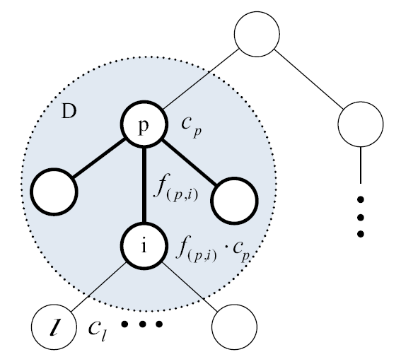
B . Throughput and fairness
With this model, we can separate each hop as an independent collision domain
A sub tree that consists of one parent as a root node, its child nodes and the links between them

Slide 16
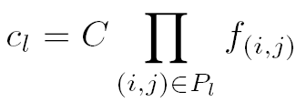
B . Throughput and fairness
The capacity of parent node P be
Child node i shares by its weight
Each child enjoy the capacity
with
the bandwidth of leaf node l becomes

Slide 17
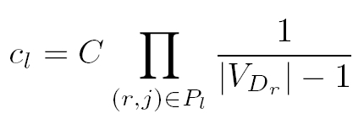
B . Throughput and fairness
On the current IEEE 802.11 MAC, all the child nodes in D share the equal bandwidth. Then, is calculated by

Slide 18

B . Throughput and fairness
Xi , for i= 1, 2,...n, denotes the bandwidth allocation vector.
Without fair scheduling , the bandwidth of each mesh router can be modeled as :
For any router i in a path
  c : capacity of internet gateway.
  : collision domain that contains node i as the parent node and is the number of child node in .

Slide 19
C . Throughput and inverse fairness index
, i = 1,2,… n. as the demand vector of mesh routers
, i = 1,2, …n. as the weight profile vector of each mesh router.
Each mesh router will enjoy a different quality of service (QoS) based on its weight profile.

Slide 20

C . Throughput and inverse fairness index
We define our inverse fairness index as follows :
is an unsatisfied bandwidth relative to mesh router i’s demand and weight.
If is too large , we need to apply our algorithm to reduce .

Slide 21

C . Throughput and inverse fairness index
In formula (3) , we also define R as average inverse fairness index of the entire wireless mesh network.
Our goal is to have an algorithm that balances fairness and network throughput.

Slide 22
C . Throughput and inverse fairness index
The algorithm try to obtain a Pareto optimal solution on the Pareto surface that relatively maximizes throughput and provides fairness among routers based on their demands and weights.
Design a trade-off between two conflicting objectives : fairness and throughput .

Slide 23
C . Throughput and inverse fairness index
Previous hard fairness solutions ( : i , j for all active node ) , assign much less bandwidth rate to each mesh router in order to achieve absolute fairness.
By doing so, the total utilized bandwidth in the network decreases. Furthermore, each mesh router transmits traffic at a low transmission rate and link capacity is wasted.
Throughput of the entire network is reduced.

Slide 24
C . Throughput and inverse fairness index
We want to assign allocated bandwidth rates to the maximum to increase throughput.
The total allocated bandwidth rates to mesh routers should be equal to the bandwidth capacity at internet gateway.
As a multi-objective optimization problem, we want to find a solution in terms of a bandwidth allocation vector which .

Slide 25
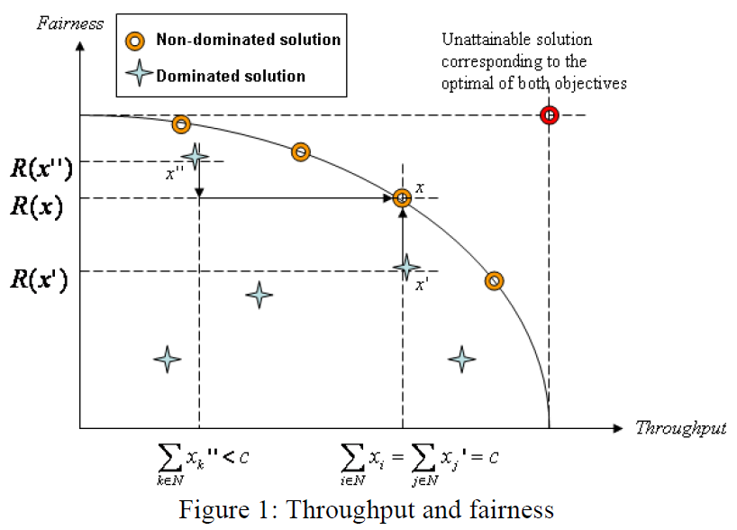
C . Throughput and inverse fairness index

Slide 26
D. The fair scheduling algorithm
The proposed fair scheduling method starts from the bandwidth allocation vector obtained from unscheduling fairness
Then, it works its way to the Pareto optimal solution x by assigning unutilized bandwidth to a set of mesh routers to improve throughput
Proposed fair scheduling method assigns it to the mesh router, which results in generating the best average inverse fairness index value in order to provide fairness in the network

Slide 27
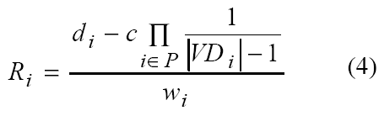
D. The fair scheduling algorithm
For proposed scheduling , we can computer (4) for each mesh router
We apply a hard fairness technique in which the average inverse fairness indexes are all equal for all mesh routers in the network

Slide 28
D. The fair scheduling algorithm
We can have n equations that can be solved
we obtain a new bandwidth allocation vector . where and
based on existing bandwidth allocation vector , we need to find another bandwidth allocation vector which is a Pareto optimal solution between fairness and throughput

Slide 29
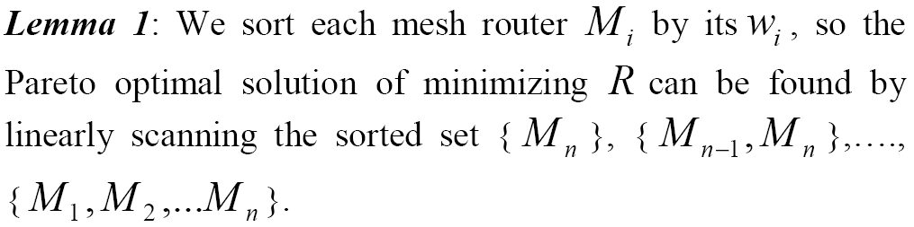
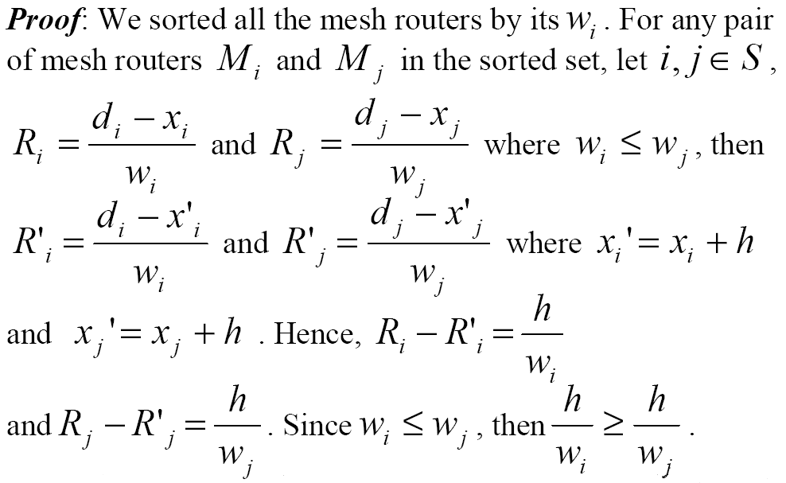
Notes:
多餘頻寬要配置給? PROOF :

Slide 30
E. Maximizing the throughput rate allocation (MTRA) problem
Since we already achieved hard fairness in the network where , but the new total throughput is less than .
By lemma 1, the optimal solution of minimizing R can be found by linearly iterating and solving the maximum throughput rate allocation (MTRA) problem for the sorted set { },{ , },…., { , ,... }.

Slide 31
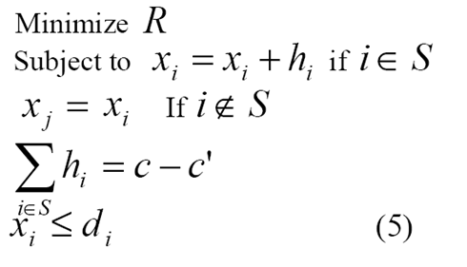
E. Maximizing the throughput rate allocation (MTRA) problem
by solving the MTRA problem, we can find the optimal solution { R* , x* } that maximizes network throughput and also achieves relative fairness.
The MTRA Problem is formulated in

Slide 32
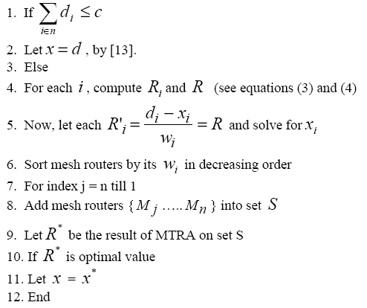
E. Maximizing the throughput rate allocation (MTRA) problem

Slide 33
Agenda
Abstract
Introduction
Proposed fair scheduling
Performance evaluation
Conclusion

Slide 34
A. Performance metrics & simulation parameters
Performance metrics
  Average inverse fairness index (IFI)
  Coefficient of Variation (C.V.)
  Total throughput
Simulation parameters
  Weight profile
  Number of mesh router
  Traffic demand (Poisson)

Slide 35
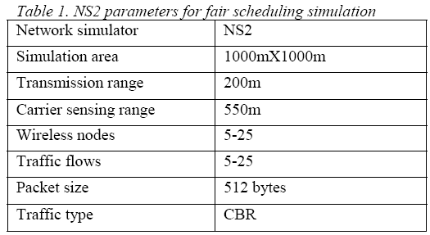
B. Simulation Setup
NS2 is used to evaluate the performance of our proposed method

Slide 36
C. Discussion of the experimental results
The performance were compared using multiple performance metrics between
  Unfair scheduling
  Hard fair scheduling methods
  Proposed fair scheduling

Slide 37
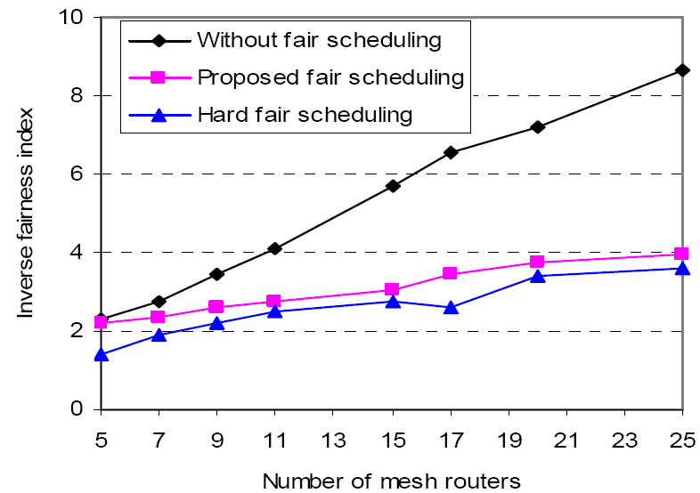
C. Discussion of the experimental results
The first set of experiments discuss about inverse fairness index

Slide 38
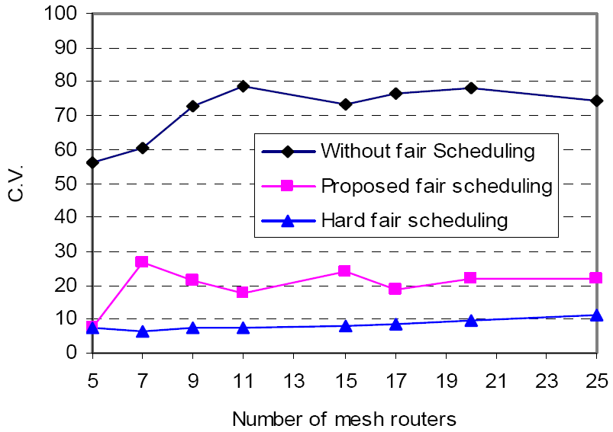
C. Discussion of the experimental results
In the second set of experiments, the effect of the number of mesh routers was investigated using the C.V. of allocated bandwidth as the performance metric.

Slide 39
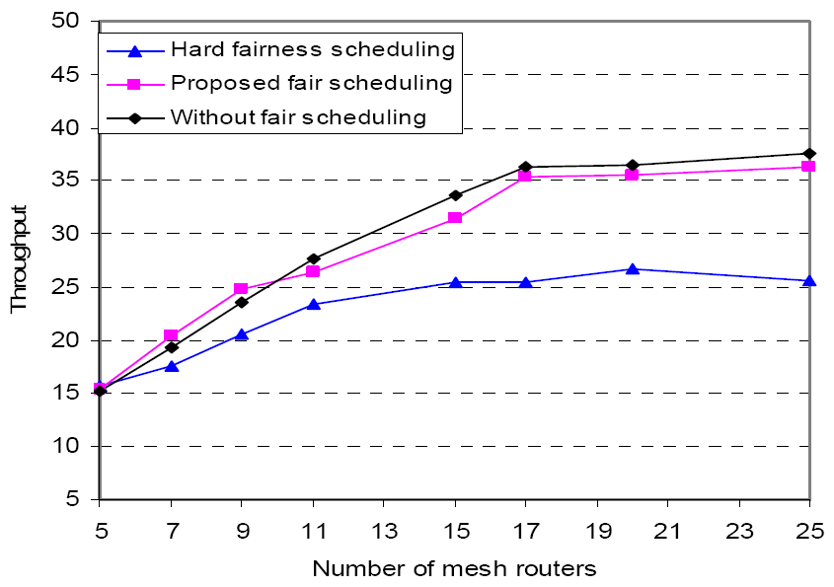
C. Discussion of the experimental results
In the third set of experiments, the performance of the proposed fair scheduling method was compared with the other two schemes

Slide 40
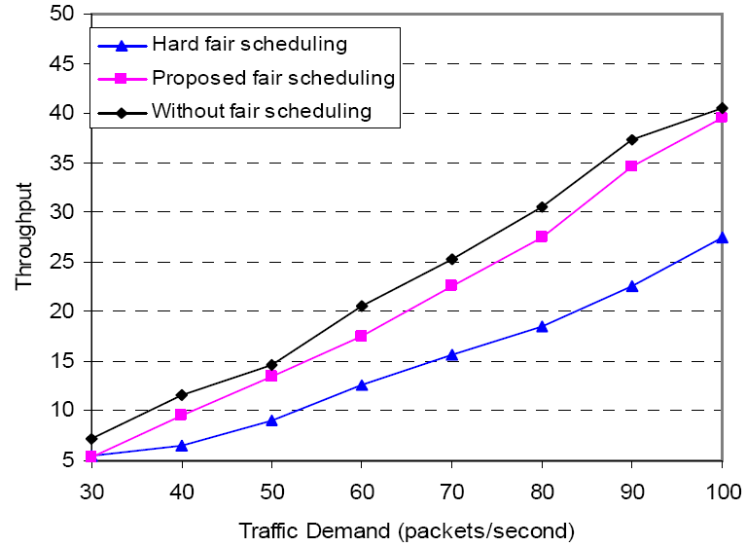
C. Discussion of the experimental results
In the fourth set of experiments, the total achieved network throughput at IGW were discuss as a function of traffic demand
Notes:
In the fourth set of experiments, the total achieved network
throughput at IGW was used as the performance metric. The
performance of the proposed fair scheduling method was
compared with hard fair scheduling and unfair scheduling
methods as a function of traffic demand. The proposed fair
scheduling method was designed to obtain a Pareto optimal
bandwidth allocation vector. This Pareto optimal solution
provides a good balance between network throughput and
fairness. As shown in Figure 5, the proposed fair scheduling
method achieved high network throughput compared to hard
fair scheduling. As traffic demand increased from 30 packets
per second to 100 packets per second, the total throughput of
the proposed fair scheduling method reached almost 40 Mbps.
The unfair scheduling method had slightly higher throughput
than the proposed method, which is attributed to its lower
performance in terms of fairness.

Slide 41
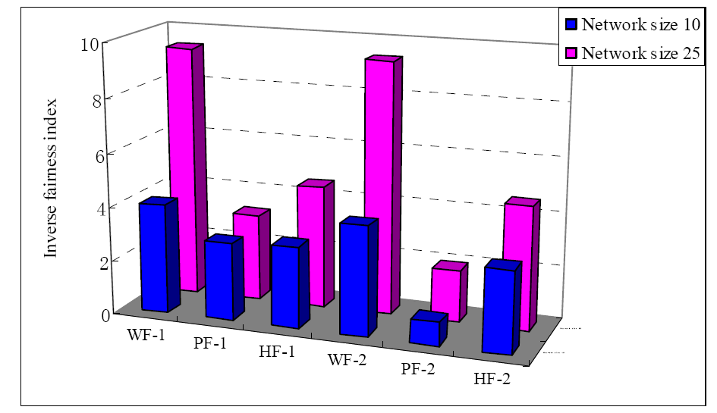
C. Discussion of the experimental results
In the fifth set of experiments, the performance of the proposed fair scheduling method was evaluated with different weight profiles
9.4
4.3
3.2
2.8
1.873

Slide 42
Agenda
Abstract
Introduction
Proposed fair scheduling
Performance evaluation
Conclusion

Slide 43
Conclusion
We proposed a fair scheduling method that maximizes the throughput of the entire network and maintains relative fairness among mesh routers.
The proposed fair scheduling method considers both the demand and weight of each mesh router.

Slide 44
Conclusion
The proposed fair scheduling method outperforms the method without fair scheduling in terms of achieving a lower inverse fairness index and low variation
Also showing better throughput performance than hard fairness

Slide 45
Conclusion
Future work
  Further analysis and performance comparison
  A cross-layer based solution for uplink and downlink fair scheduling
  Mobile routers

Slide 46
Thanks for your listening !

Slide 47
We propose:
  Hard fairness in different hops from gateway : estimating the weight of each node
  Maximize throughput based on hard fairness

