Slide 1
論文進度報告
Advisor: Prof. Frank Yeong-Sung Lin
presented by Yi-Wei Li

Slide 2
Agenda
Introduction
Notation and Problem Formulation
LR problem and subproblems
Heuristics

Slide 3
Title
Joint flow control, capacity allocation and routing to achieve end-to-end delay and throughput fairness in wireless mesh networks
基於配置頻寬、流量控制與路由決策達成具端點至端點延遲及吞吐量公平之無線網狀網路營運

Slide 4
Introduction

Slide 5
Introduction

Slide 6
Problem description
Given :
  Network topology
  The capacity of mesh routers and gateways
  The traffic rate required by each mesh client
Objective :
  To maximize the minimum rate of all clients

Slide 7
Problem description
Subject to :
  Routing constraints
  Mobile host constraints
  Link capacity constraints
  QoS constraints
  Link constraints
  Flow control constraints
To determine :
  The end-to-end delay
  The data rate of clients

Slide 8
Notation and Problem Formulation

Slide 9
Introduction of Notations
N | The set of mesh clients, where n∈N.
R | The set of mesh routers, where r∈R.
G | The set of gateways, where g∈G.
 | The nodal capacity of router r.
 | The air-interface capacity of router r.
 | The capacity of wired line on gateway g.
 | The average delay on link ij, which is a function of aggregate flow f_{ij} and capacity c_{ij}.

Slide 10
Introduction of Notations
 | The average delay on host n to router r, which is a function of transmission rate and air-interface capacity .
P_{rg} | A given set of simple directed paths from the router r to the gateway g , where p∈ P_{rg}
 | The indication function which is 1 if link from router i to router j is on path p and 0 otherwise.
 | (pkt/sec) The arrival rate of each client n∈N.
α_{ij} | A given link utilization factor which keeps link ij from saturated.
R_{r} | The service range of mesh router r.

Slide 11
Introduction of Notations
k_{nr} | 1 if mobile client n associates to mesh router r and 0 otherwise.
β_{n} | A given delay priority factor which equals to 1 means delay of client n∈N equals to D and β_{n} is inverse proportional to the priority of client n. The lower value of β_{n} means client n enjoy less end-to-end delay.

Slide 12
Introduction of decision variables
γ_{n} | (pkt/sec) The allowed arrival rate of new traffic for each client n∈N.
y_{n} | (pkt/sec) The rejected arrival rate of new traffic for each client n∈N.
 | (pkt/sec) The link capacity (air-interface) of router r to client n.
f_{ij} | (pkt/sec) The aggregated flow of each link ij.
c_{ij} | (pkt/sec) The allocated capacity (nodal) of each link ij.
x_{p} | A routing decision variable which is 1 when path p∈P_{rg} is used to transmit the packets for client n and 0 otherwise.

Slide 13
Introduction of decision variables
t_{rij} | 1 if link ij is on the path adopted by mesh router r and 0 otherwise.
z_{rg} | 1 if router r connects to the wired network via gateway g and 0 otherwise.
D | The end-to-end delay requirement.

Slide 14
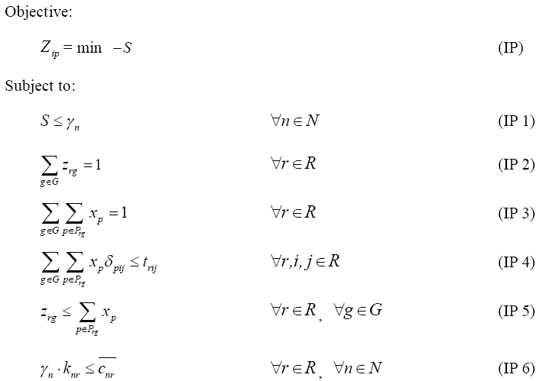

Problem formulation

Slide 15
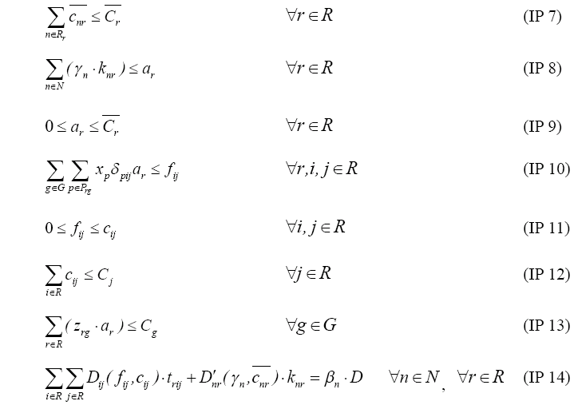
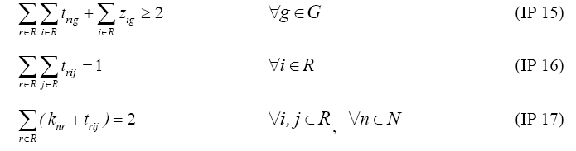

Slide 16
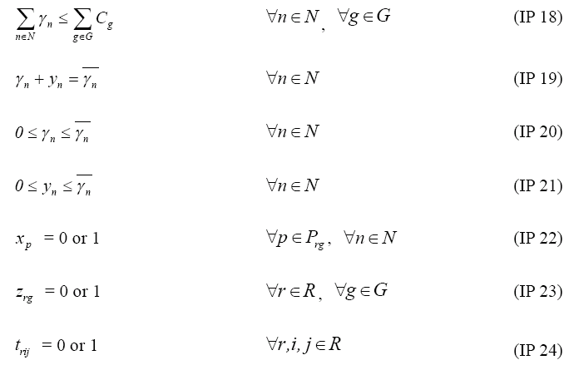

Slide 17
LR problem and subproblems

Slide 18
We relax constraints 1, 4, 7, 9, 11, 12, 14, 15, 16, 18, 20, 5 to (LR) with LR multipliers
. .
are unrestricted and are non-positive.

Slide 19
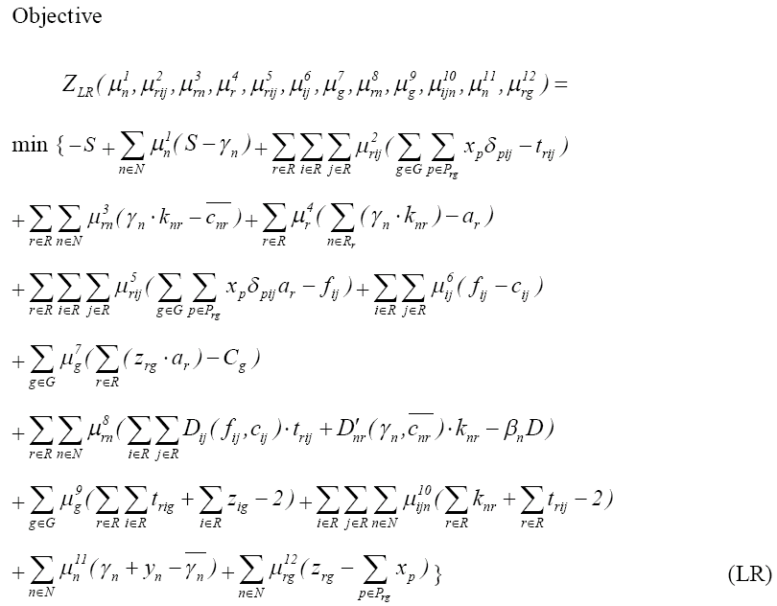

Slide 20
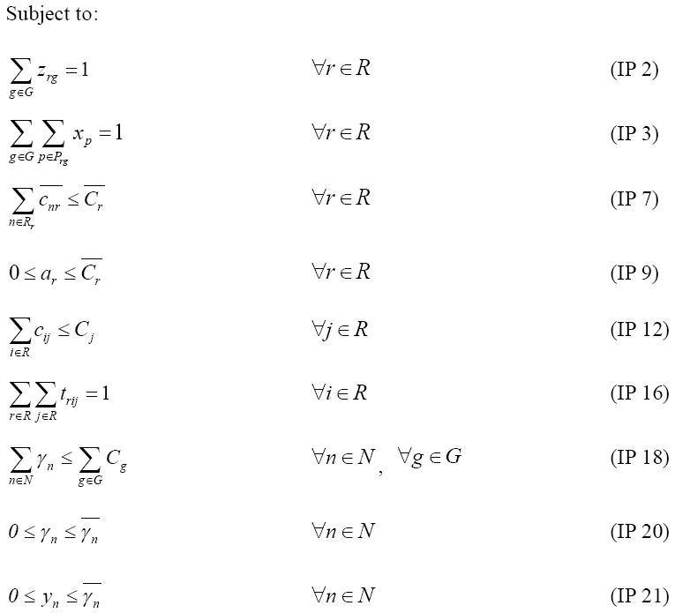

Slide 21
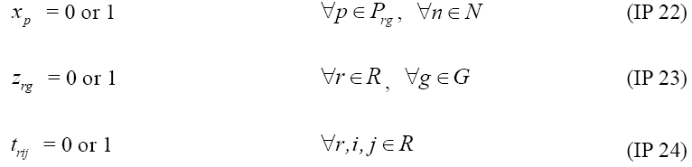

Slide 22
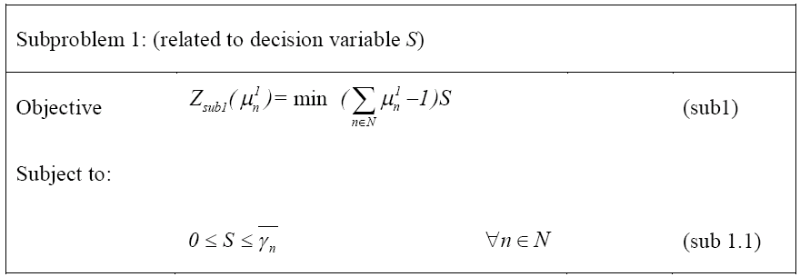
Compute the coefficient of S for each client n
Choose the minimum one and If
  Positive → assign 0 to S
  Negative → assign to S

Slide 23
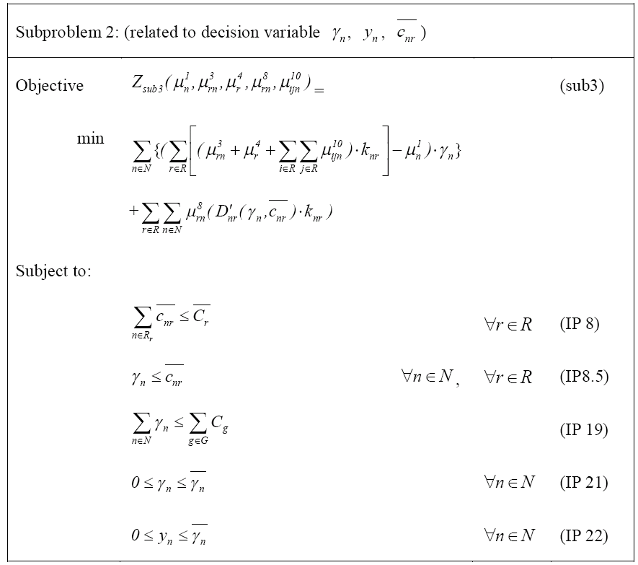


Slide 24
Sub 2
If k_{nr} = 0
  Set all to 0.
  Calculate the coefficient of , and choose the minimum one. Set , .
  Repeat step 2 until .
Else
  Let , where E is a discrete capacity set.
  the obj =
  For each , we analysis the objective function and find the minimum value.

Slide 25
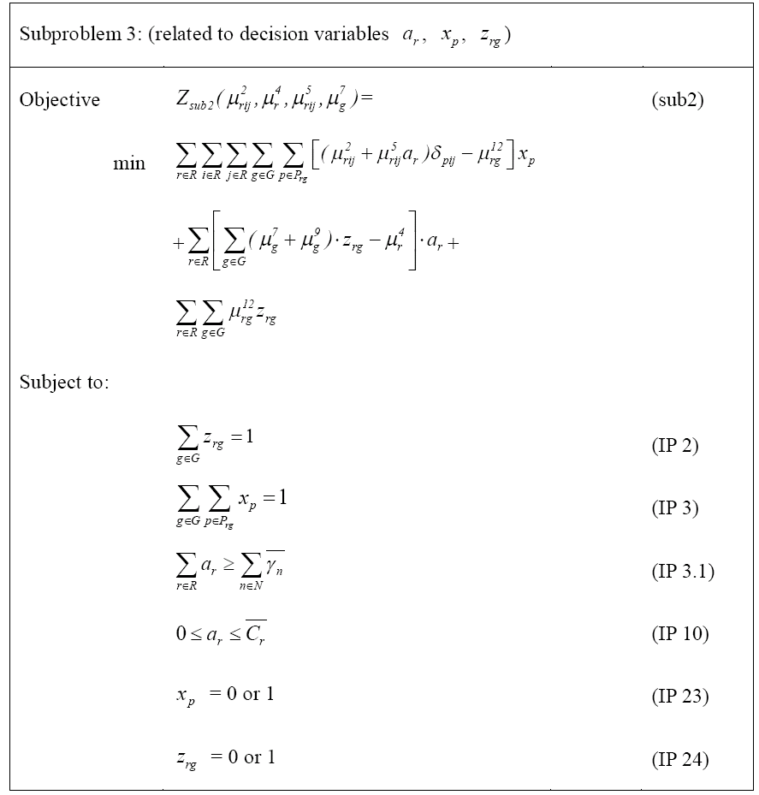


Slide 26
Sub 3
Set all a_{r} to 0.
Calculate coefficient of a_{r} with z_{rg} =0 and z_{rg} =1.
Choose the smallest one and set the value z_{rg} and
Repeat step 3 until is satisfied.

Slide 27
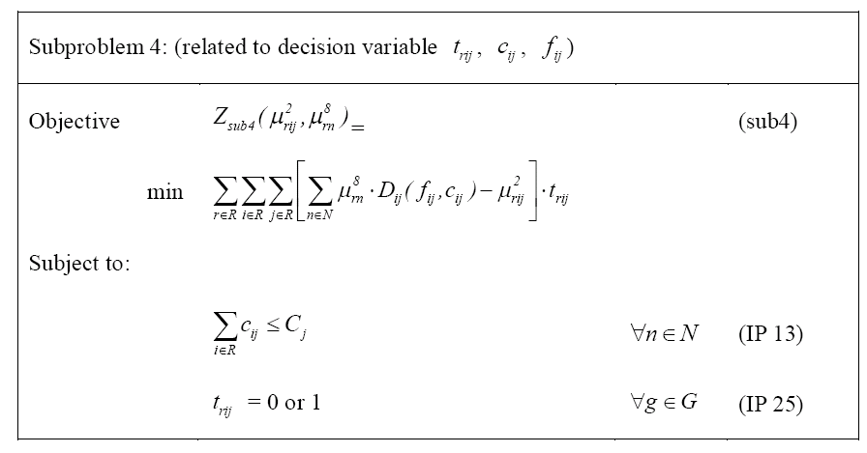

Slide 28
Sub 4
Let .
For each r with c_{ij} , solve .
Sort these f_{ij} .
At each interval, analysis the local minimum value.
The global minimum point can be found by comparing these local minimum points.

Slide 29
Getting Primal Feasible Solutions

Slide 30
Getting Primal Feasible Solutions
Step1: Run gateway_selection_heuristic
Step2: Run routing_heuristic
Step3: Run flow_control_heuristic
Step4: Run capacity_adjust_heuristic
Step5: examine the latency we can tolerance or not
Y: End
N: go back to Step1.

Slide 31
Gateway_selection_heuristic
Step 1: Initial gateway selection assignment according to z_{rg}.
Step 2: Find the gateway g that violate capacity most seriously. If not found, the stop.
Step 3: For each router r belonging to gateway g, we sort by a_{r} and choose the smallest one.
Step 4: For this r with a_{r}, we reassign to another gateway with smallest hop-count distance.
Step 5: Repeat step 2, 3, and 4 until all clients can be admit.

Slide 32
Routing_heuristic
Step 1: set the arc weight for each link to be the coefficient of variable x_{p}.
Step 2: run Dijkstra’s algorithm to get the shortest path from each router.

Slide 33
Flow_control_heuristic
With given path, we implement max-min flow control to calculate how much rate a client can transmit.
Input rate vector of all flows start at zero;
Equivalent increase the rates on all paths together until the bit rates of some flows are constrained by the capacity set;
Freeze the bit rate of these flows;
Apply step 2 repeatedly to non-frozen flows until the bit rate of all flows are constrained by the capacity set.

Slide 34
Capacity_adjust_heuristic
Step 1: For each leaf router r, examine the latency violating QoS constraint or not. If not, compute the aggregated flow and transmit to it’s next router.
Step 2: In this router r, select c_{ir} with the smallest coefficient (or ∆D) and c_{jr} with the largest coefficient (or ∆D), reallocate the capacity in such a way .
Step 3: Repeat Step 2 until all D_{r’r} are the same.
Step 4: Go to Step 1 until we calculate the gateway capacity allocation.

Slide 35
Thanks for Your Listening!

